Slide 1
Making Server Calls and Persisting Data
Jon Galloway | Technical Evangelist
Christopher Harrison | Content Developer

Slide 2
Making server calls and persisting data
Knockout and Ajax
Entity Framework overview
Loading data with Ajax
Saving data with Ajax
SignalR

Slide 3
Knockout and Ajax

Slide 4
Entity Framework Overview

Slide 5
Entity Framework
Entity Framework (EF) is an object-relational mapper that enables .NET developers to work with relational data using domain-specific objects.
EF7 is cross-platform, more lightweight, and works with non-relational databases.
Not required for Knockout, we’re just showing it as an example.

Slide 6
Entity Framework Resources
https://github.com/aspnet/EntityFramework
Implementing Entity Framework with MVC
What’s New With ASP.NET 5 (EF7)

Slide 7
Loading Data

Slide 8
Loading Data via Ajax

Slide 9
Saving Data via Ajax

Slide 10
SignalR and Realtime Knockout

Slide 11

SignalR on Older Servers or Clients
Got Data?
Got Data?
Got Data?
Here’s some data!
Got Data?
Got Data?
Client
Server
Got Data?

Slide 12
SignalR on Modern Servers or Clients
I do real-time, do you?
Yep!
Let’s Party in Real-time!
Client
Server

Slide 13
SignalR Fallback
Long Polling
Forever Frames
Server Sent Events
Web Sockets

Slide 14
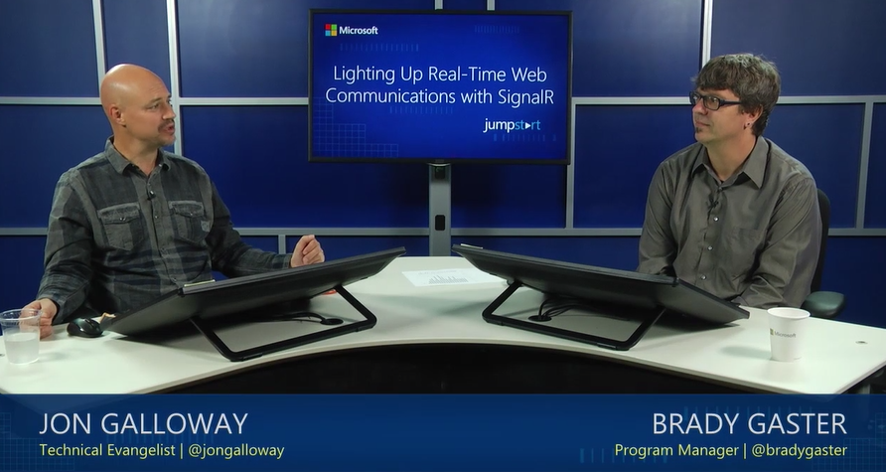
MVA: Lighting Up Real-Time Web Communications with SignalR

Slide 15
Calling SignalR with Knockout objects
SignalR automatically serializes JavaScript objects
ko.toJSON converts an object to JSON string
SignalR doesn’t want JSON, it just wants the object
ko.toJS converts a Knockout object to a JavaScript object

Slide 16
Knockout and SignalR serialization
hub.server.save(item);
FAIL!
You’re trying to upload a wrapped object
hub.server.save(ko.toJSON(item));
FAIL!
SignalR wants the object, not a JSON string
hub.server.save(ko.toJS(item));
Success!!

Slide 17
Saving and Updating via SignalR

